Slide 1
Voting process(Queue)
Presented by
R.Ramyasree(24KB1A3089)
G.Harshitha(24KB1A3030)
J.Neha(24KB1A3037)

Slide 2
Introduction :
Purpose of the Project:
Simulate a real-world voting system using a queue data structure.
Why Queue?
First-In-First-Out (FIFO) principle ensures fairness in voting.
Key Features:
Enqueue voters.
Dequeue after voting.
Track vote count securely.

Slide 3
What is a Queue ?
Definition: Linear data structure following First In First Out (FIFO) principle.
Elements added at the rear, removed from the front.
Real-life analogy: People standing in a line to vote.

Slide 4
Queue operations:
Main operations:
enqueue(): Add element to rear
dequeue(): Remove element from front
isEmpty(): Check if queue is empty
isFull(): Check if queue is full
Front and Rear pointers manage queue state

Slide 5

Why we use a queue in voting systems?
Ensures orderly processing of voters (first-come, first-served).
Prevents multiple voting by same person.
Simplifies vote counting by sequential processing

Slide 6
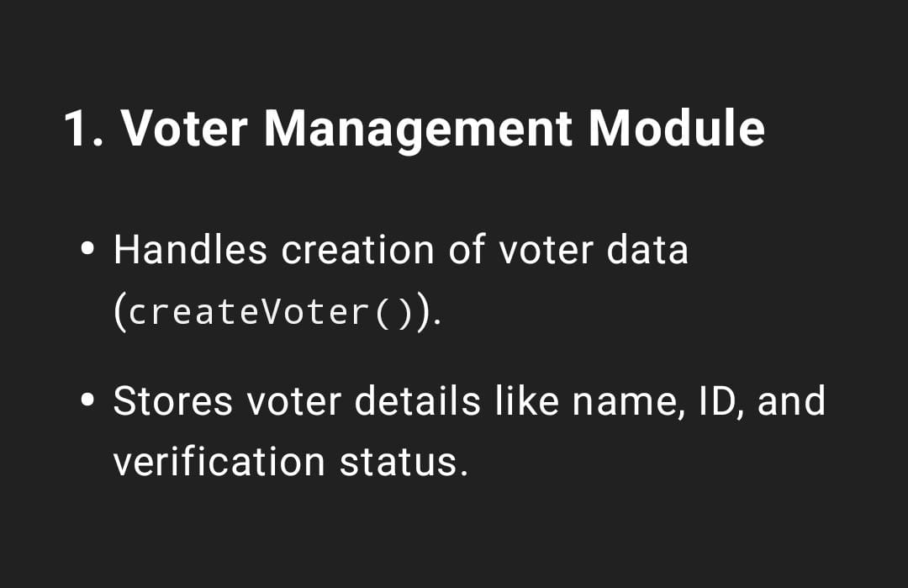

Slide 7
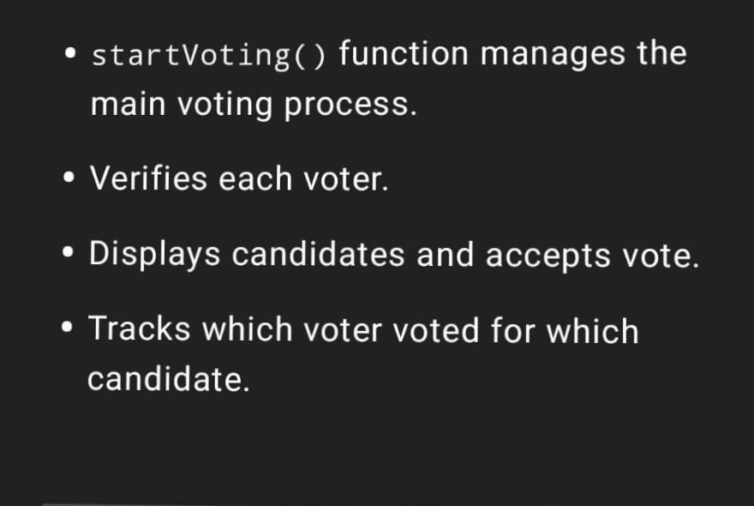
Voting process module

Slide 8
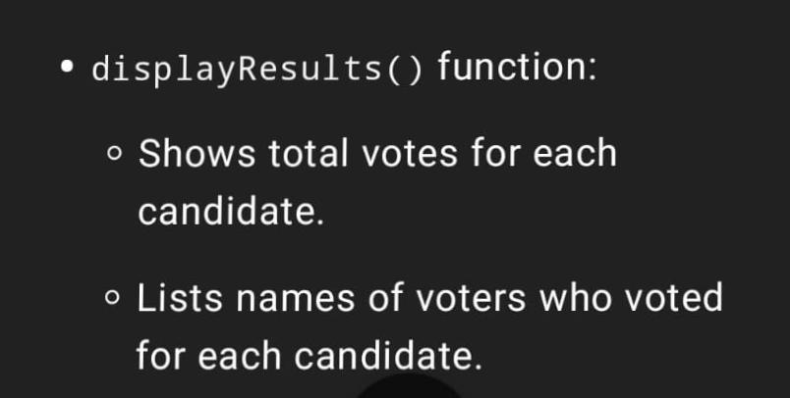
Result display module:

Slide 9
System requirements:
C programming language.
Basic knowledge of arrays and structures.
Console-based interface for demonstration.
System design overview:
Voters register and are added to the queue.
Each voter votes when their turn arrives (dequeued).
Votes are recorded and tallied- Results displayed after all voters have voted.

Slide 10
Data structures used:
Queue implemented using array.
Structure for voter details:
- Voter ID, Name, Voted (Yes/No), Vote (Candidate ID).
- Array to store votes for each candidate.

Slide 11

Vote registration:
Voter provides details (ID, Name).
Added to the queue using enqueue().
Only registered voters can vote.
Voting process:
Voter dequeued when their turn arrives.
System checks if voter has already voted.
Voter selects candidate; vote recorded- Prevents double voting.
Vote counting:
After all voters have voted, system tallies votes.
Array stores count for each candidate.
Results displayed to user.

Slide 12
Output example:
Show sample input/output:
- Voter registration.
- Voting process.
- Final vote tally.

Slide 13
Advantages of Queue-Based on voting system:
Simple, fair, and prevents manipulation.
Easy to implement and debug.
Scalable for larger elections.
Limitations and improvements:
Limited by queue size (array implementation).
No real-time authentication in console version.
Can be extended with linked list for dynamic size.

Slide 14
Conclusion:
Queue ensures fair, sequential voting.
C implementation demonstrates core data structure concepts.
Foundation for more advanced, secure voting systems.
Further enhancements:
Unique voter identification: Assign each voter a unique ID ensure one vote per person.
Prevents impersonation and duplicate voting.
Biometric or OTP verification.

Slide 15
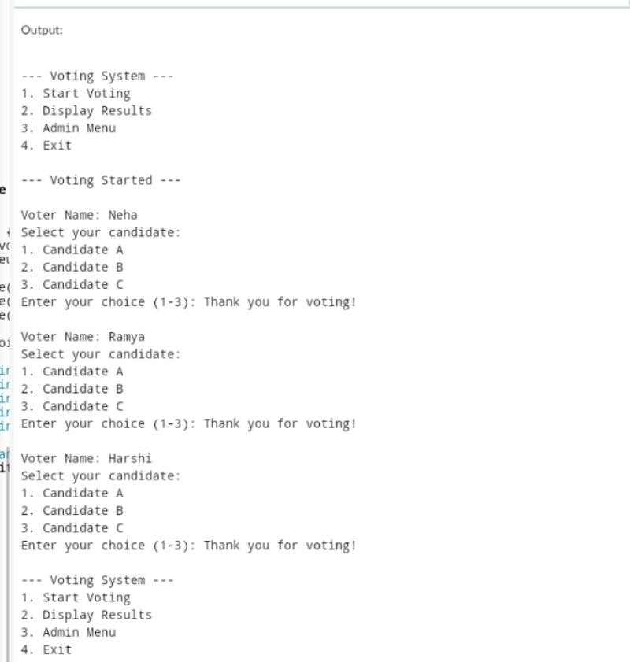
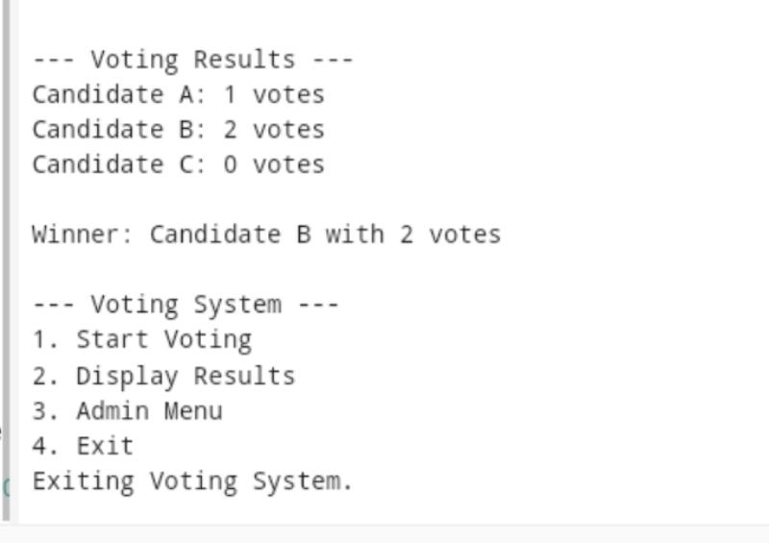
Source output

Slide 16
Thank you

